Slide 1
Handover Presentation
Ingen Dynamics
Paulina S

Slide 2
Program Overview
Products analyzed: Fari, Sentinel Prime AI, Senpai
Public-data market sizing, segmentation, competitor analysis, and dashboard development
Objectives
Evaluate commercial opportunities across three product verticals
Build a reusable market warehouse
Develop customer segmentation methodology
Produce market recommendations
Essential deliverables
Market analyses
SQL warehouse
Clustering analysis
Interactive dashboard
Executive memo

Slide 3
Research Methodology
Public data sources used
US Census
BLS
OECD
Pew Research
Security Industry Association
SEC EDGAR
JSAER
arXiv
NIH
NCES
Learning Policy Institute
Competitor websites
Evaluation methods
Top-down market sizing
Bottom-up market sizing
Competitor benchmarking
K-Means clustering
SQL warehouse design

Slide 4
Fari Market Opportunity
Data: US Census, Pew, OECD, BLS, NIH
Total Addressable Market:
12.3 million potential users
Serviceable Addressable Market:
5.2 million seniors (living alone)
Primary drivers
Aging population
Caregiver shortages
Rising care costs
Increasing technology adoption among seniors
Key Risk
Adoption and trust barriers
Human care replicability concerns
Affordability

Slide 5
Sentinel Prime AI Market Opportunity
Data: BLS, SIA, SEC EDGAR, JSAER, arXiv
Total Addressable Market:
$43.4 billion
Serviceable Addressable Market:
$34.0 billion
Primary drivers
Security workforce shortages
Rising labor costs
AI surveillance adoption
Increasing operational complexity
Key Risk
Privacy and regulatory concerns
Demographic discrimination

Slide 6
Senpai Market Opportunity
Data: Kaggle dataset (Global AI in Education Dataset 2015–2026: Adoption, EdTech, Policy Trends Usage),
Learning Policy Institute, NCES
Key Findings
United States identified as highest-readiness market
49.5 million public school students
Significant teacher shortages
Strong tech infrastructure readiness
Key Insight
Implementation capacity appears to be a stronger predictor of educational AI adoption than demand alone.

Slide 7
Competitive Positioning
Fari (eldercare)
Competitors often focus on companionship OR health support
Sentinel (security)
Competitors focus on robotics OR video analytics
Senpai (education)
Many competitors remain software-only
InGen Advantage
Integrated platform approach
Shared Origami AI architecture
Multiple sensing technologies
Embedded governance controls

Slide 8
Customer Segmentation Analysis
Three Segments Identified
Cluster 0: Emerging Growth Markets
Cluster 1: Established Education Markets
Cluster 2: High-Readiness Market (United States)
Key Insight
Tech/internet infrastructure readiness and implementation capacity (policy and budget) drive adoption more strongly than user AI interest alone.

Slide 9
Strategic Recommendations
Priority 1
Sentinel Prime AI
Largest quantified market opportunity
Priority 2
Fari
Strong demographic trends
Priority 3
Senpai
Promising market but requires additional commercial validation and research

Slide 10
Key Risks & Uncertainties
Unknowns to the analysis
Customer willingness to purchase
Pricing sensitivity
Distribution effectiveness
Regulatory evolution
Competitive response
Future validation needed
Customer interviews
Pilot deployments
Product trials
Commercial testing

Slide 11
Repository & Dashboard Handover
Repository Includes
SQL warehouse
Streamlit dashboard
Market analyses
Clustering notebook
Documentation
Dashboard Views
US Market Overview
Fari
Sentinel Prime AI
Competitor Explorer

Slide 12
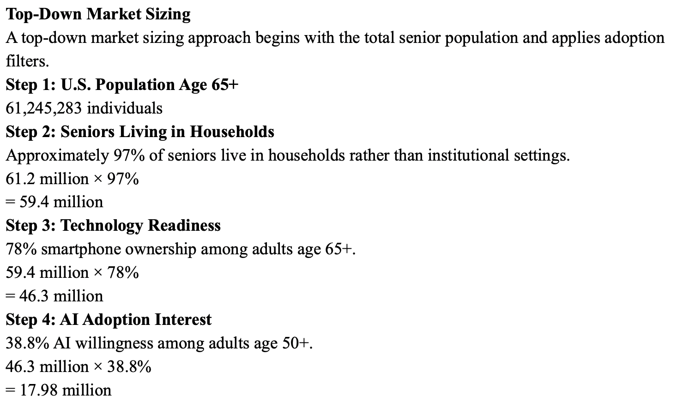
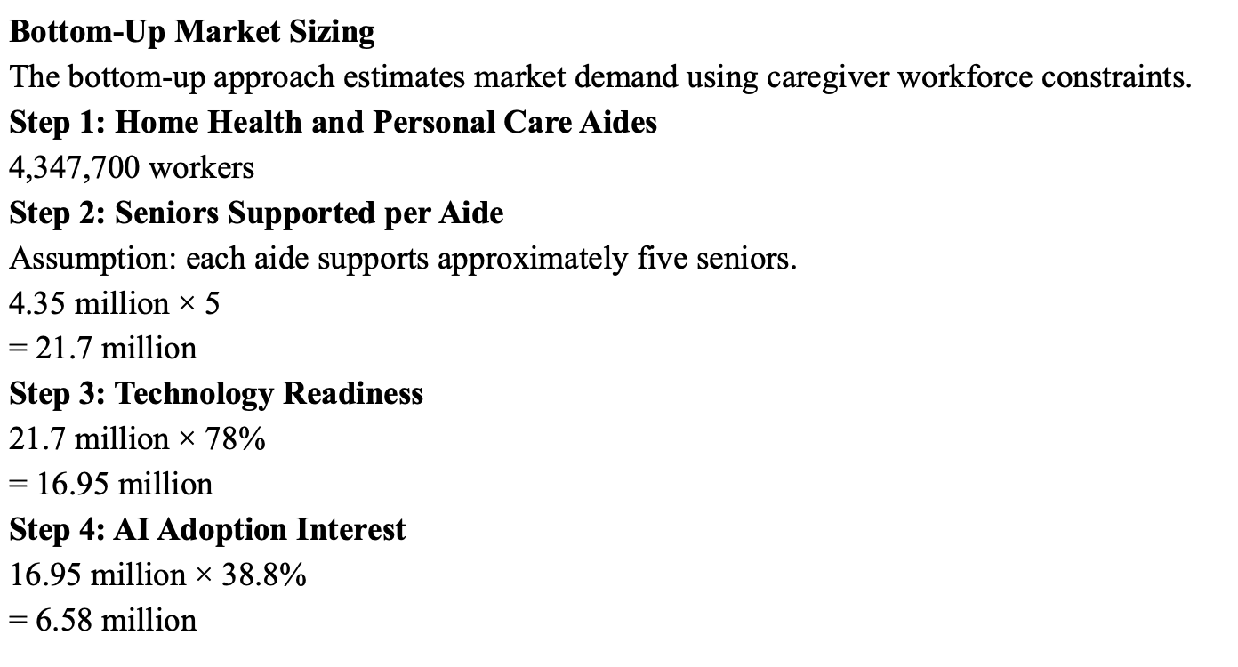
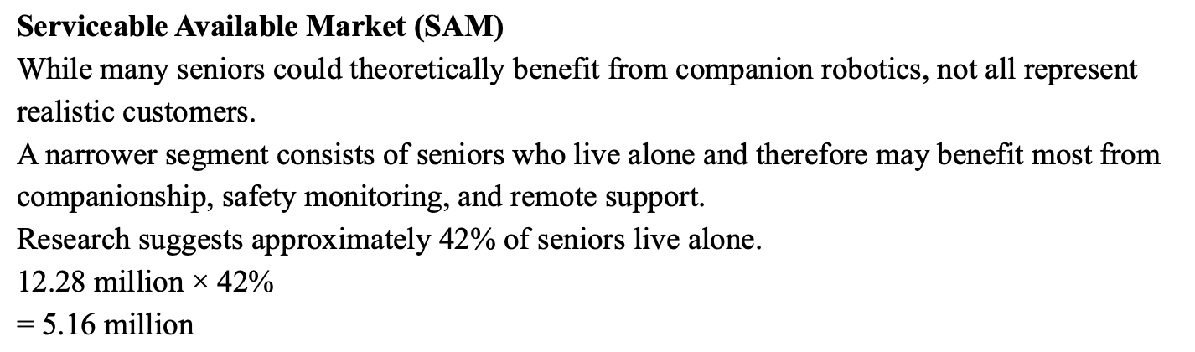
Appendix A – Fari Sources & Calculations
eldercare_market_analysis_v1.docx

Slide 13
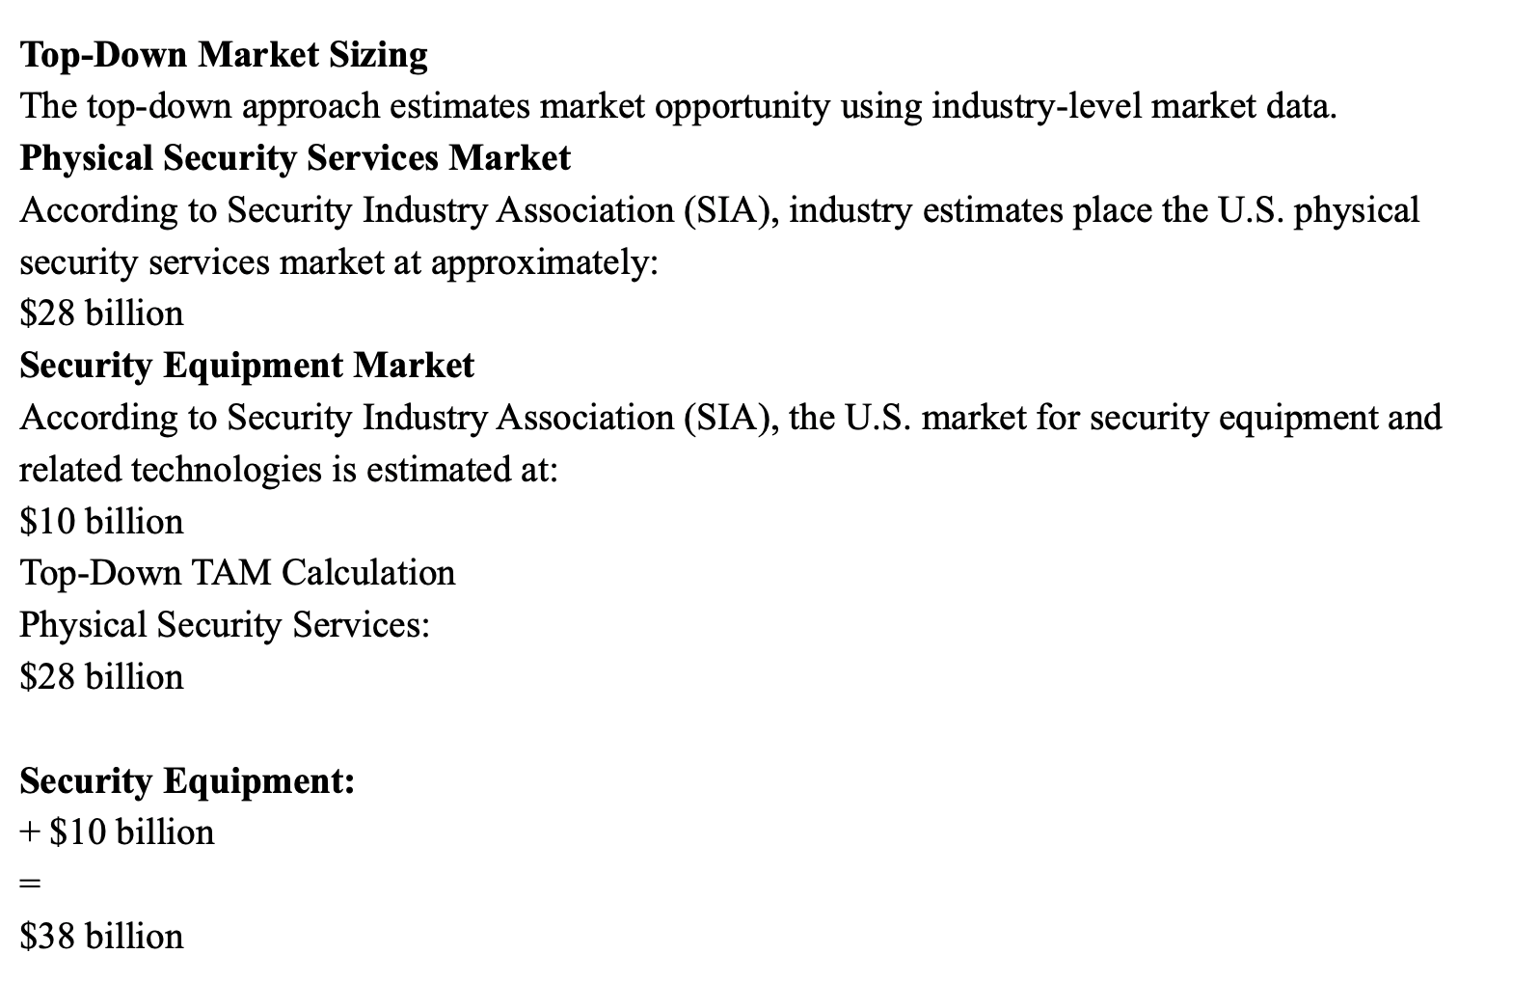
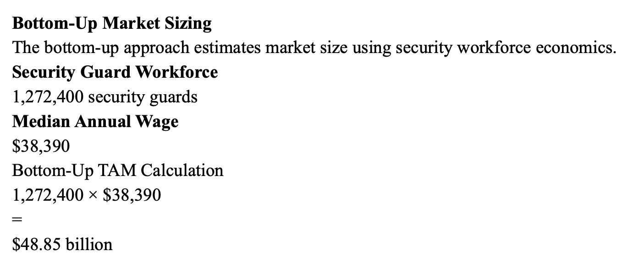
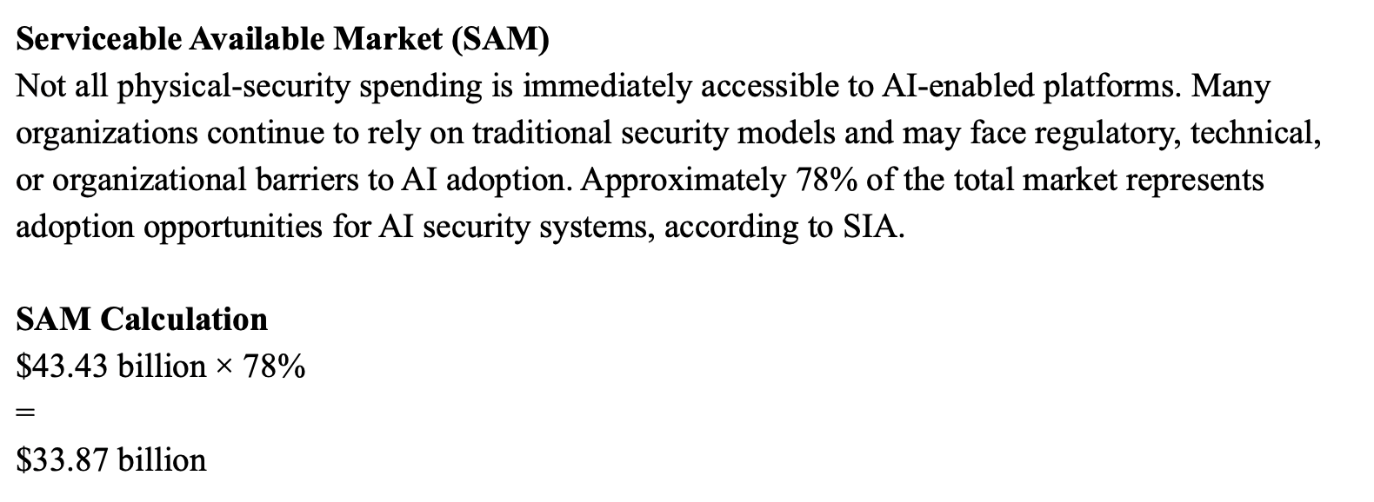
Appendix B – Sentinel Sources & Calculations
security_market_analysis_v1.docx

Slide 14
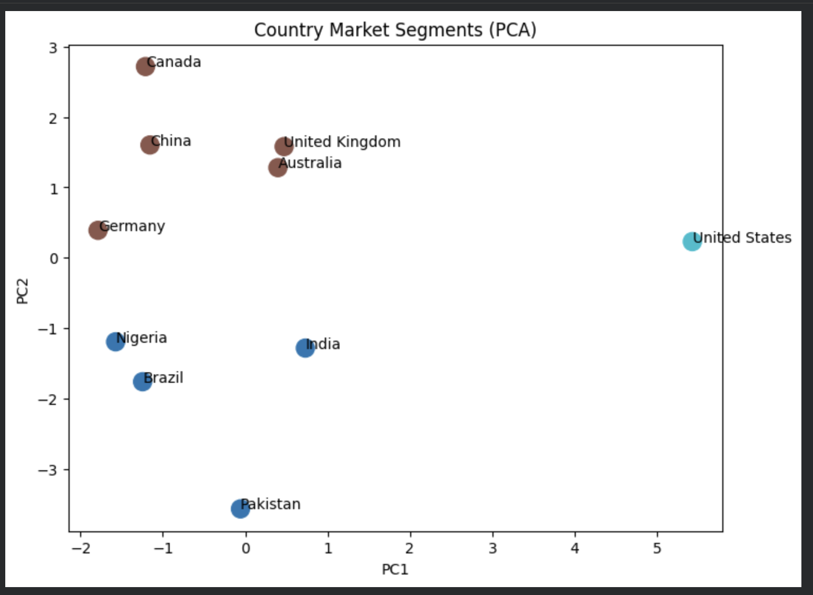
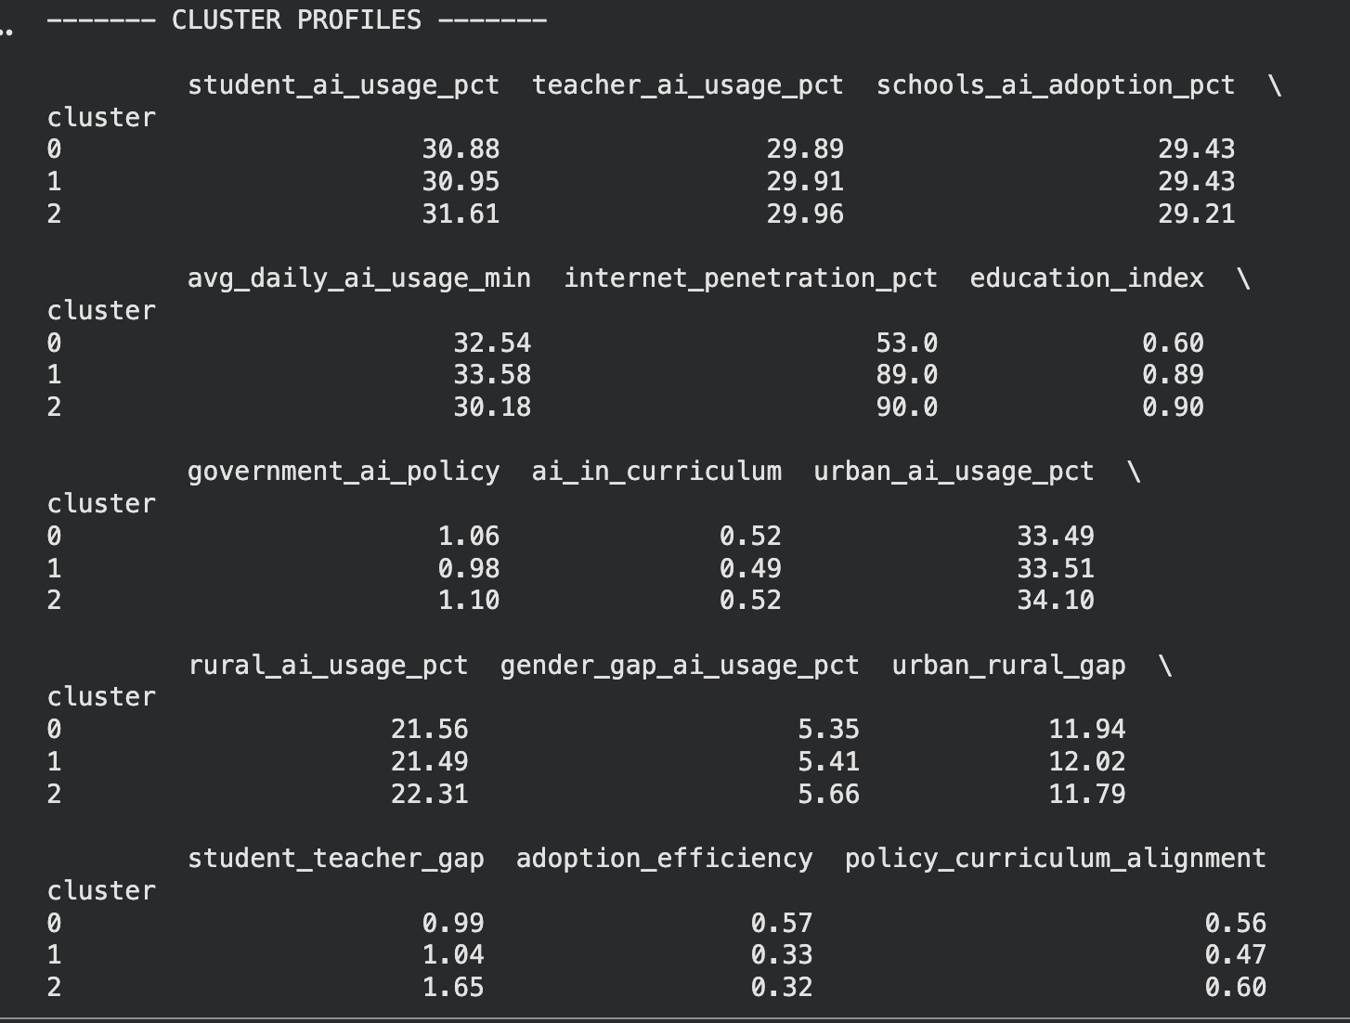
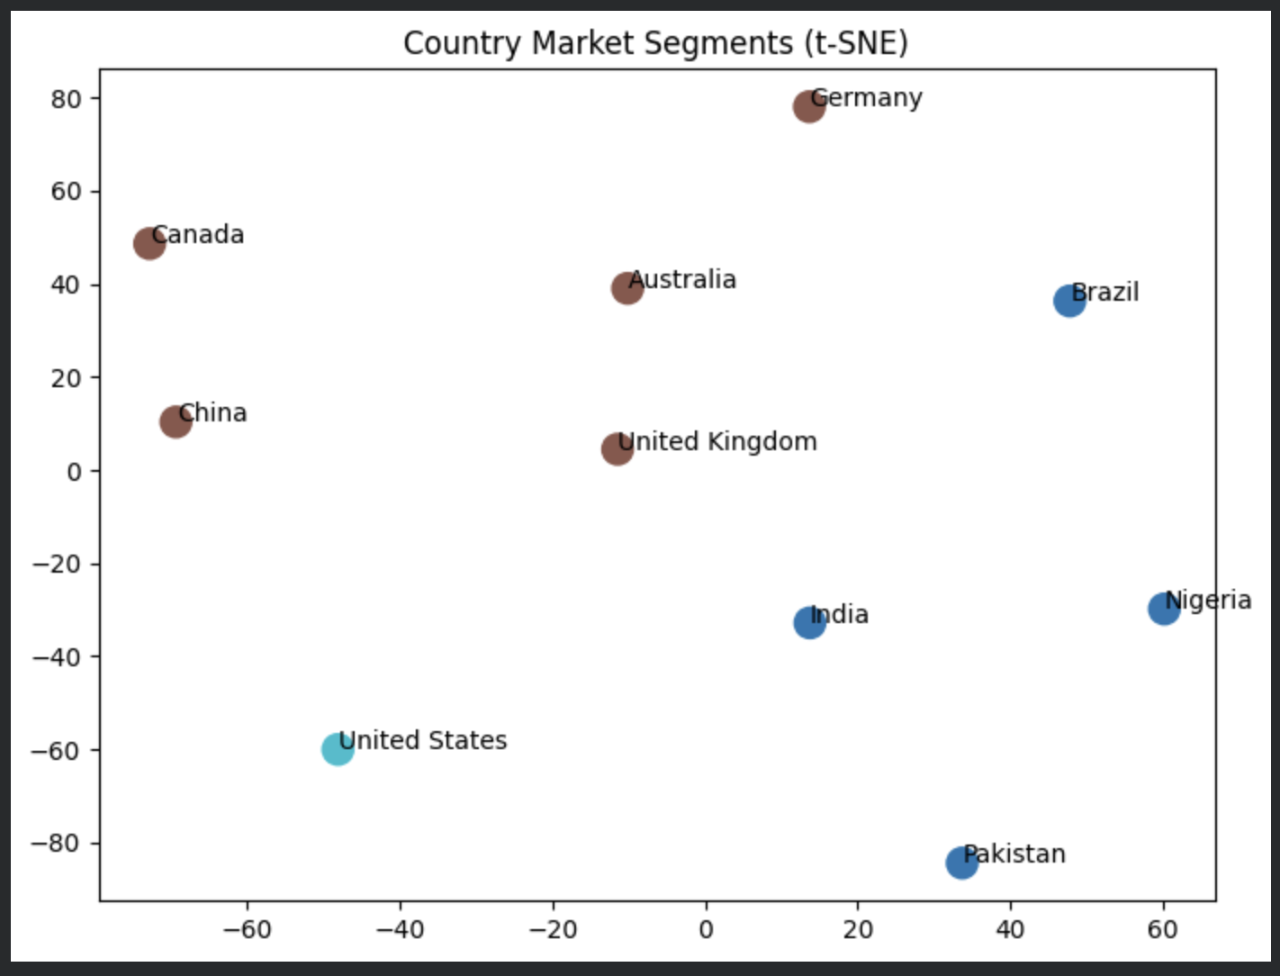
Appendix C – Senpai Clustering
segmentation_notebook_v1.ipynb
senpai_buyer_framing_v1

Slide 15
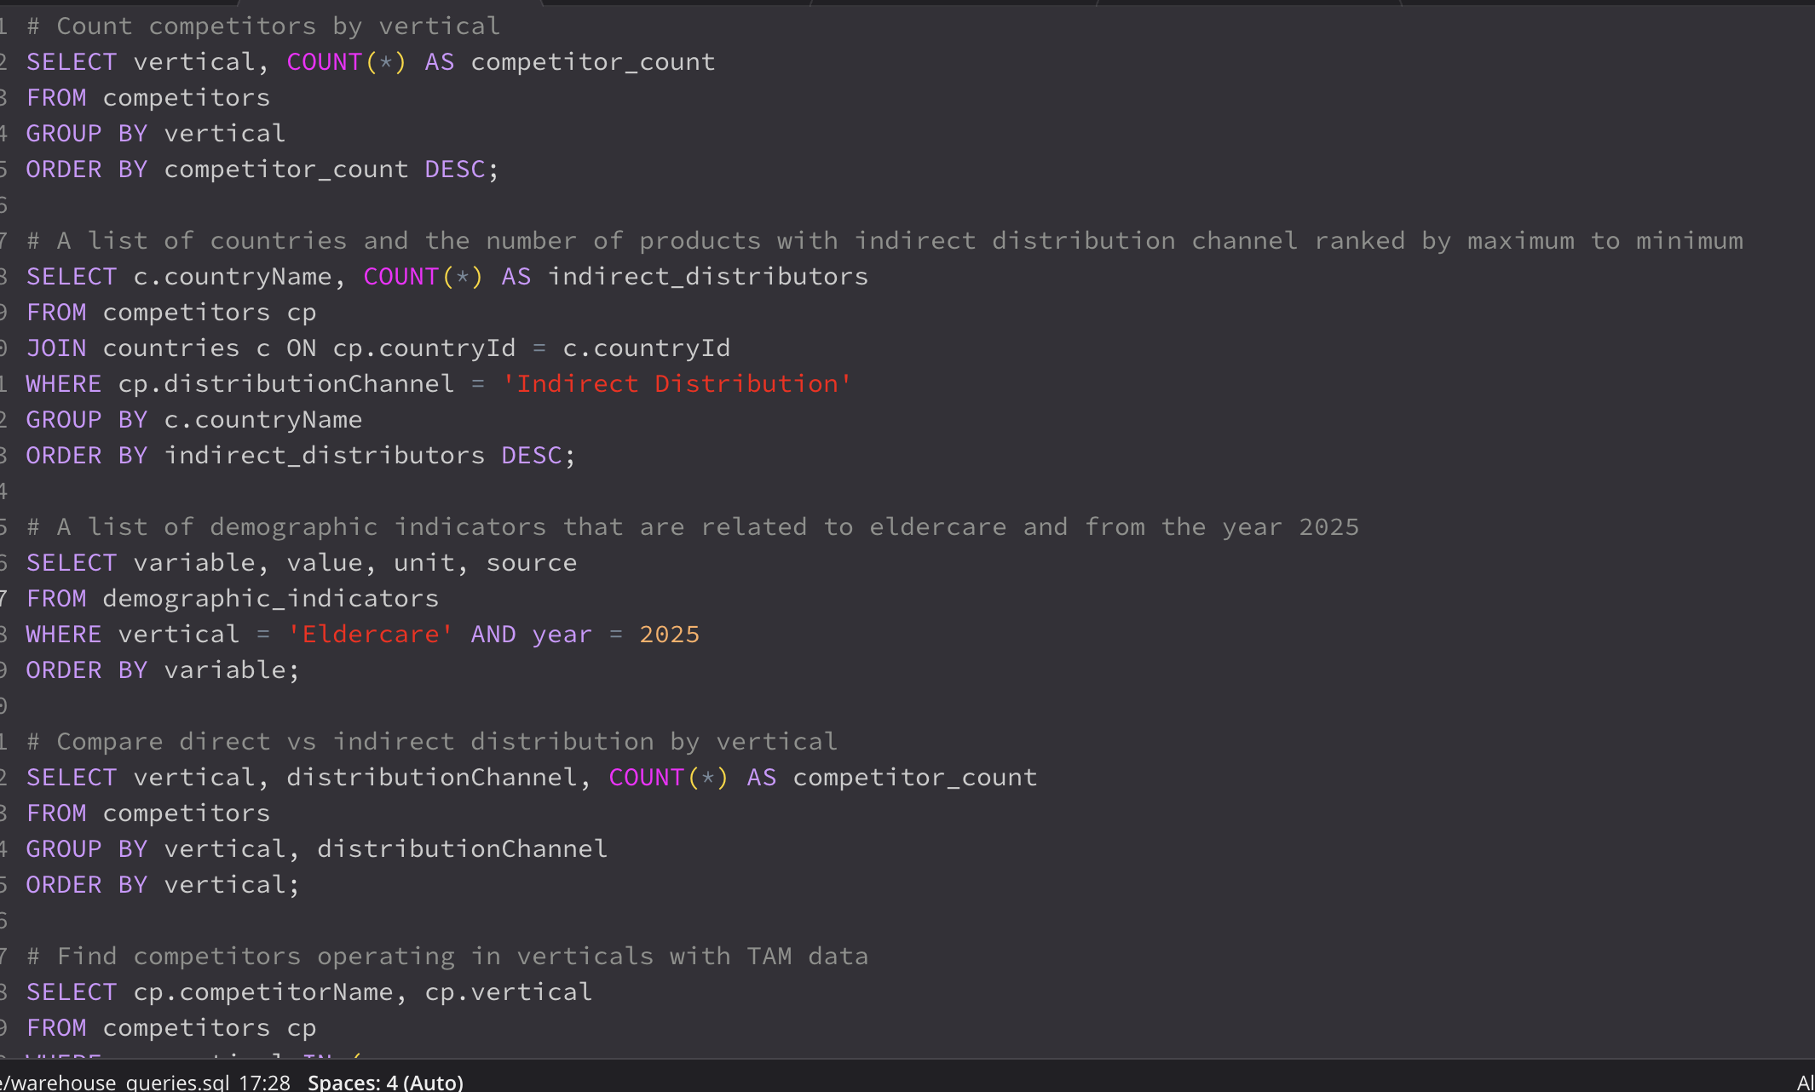
Appendix D – SQL Warehouse
ingen_market_warehouse.sqlite
warehouse_queries.sql

Slide 16
Thank you!

